Slide 1

Introduction To Object-Oriented Programming
Chapter 4 – Working with Lists

Slide 2
Looping Through an Entire List
You’ll often want to run through all entries in a list, performing the same task with each item. For example, in a game you might want to move every element on the screen by the same amount.
When you want to do the same action with every item in a list, you can use Python’s for loop.

Slide 3
Looping Through an Entire List
Say we have a list of magicians’ names, and we want to print out each name in the list. We could do this by retrieving each name from the list individually, but this approach could cause several problems.
For one, it would be repetitive to do this with a long list of names. Also, we’d have to change our code each time the list’s length changed.
Using a for loop avoids both of these issues by letting Python manage these issues internally.

Slide 4
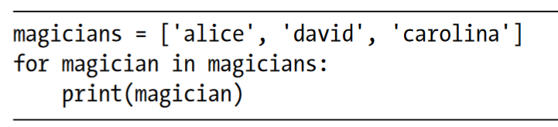
Looping Through an Entire List
First, we define a list. Then, we define a for loop. This line tells Python to pull a name from the list magicians, and associate it with the variable magician. Next, we tell Python to print the name that’s just been assigned to magician. Python then repeats these last two lines, once for each name in the list. It might help to read this code as “For every magician in the list of magicians, print the magician’s name.”

Slide 5
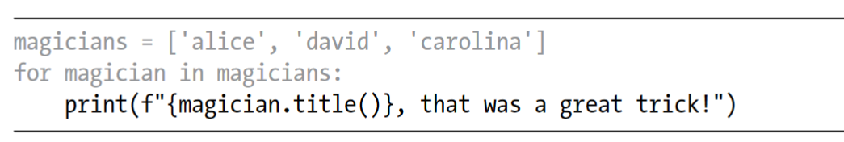
Doing More Work Within a for Loop
You can do just about anything with each item in a for loop.
The only difference in this code is where we compose a message to each magician, starting with that magician’s name. The first time through the loop the value of magician is 'alice', so Python starts the first message with the name 'Alice'. The second time through, the message will begin with 'David’, and the third time through, the message will begin with 'Carolina'.

Slide 6
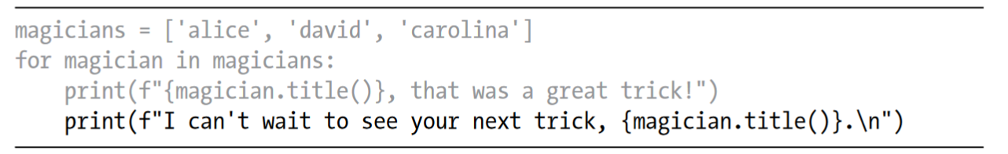
Doing More Work Within a for Loop
You can also write as many lines of code as you like in the for loop. Every indented line following the line for magician in magicians is considered inside the loop, and each indented line is executed once for each value in the list.
Therefore, you can do as much work as you like with each value in the list.

Slide 7
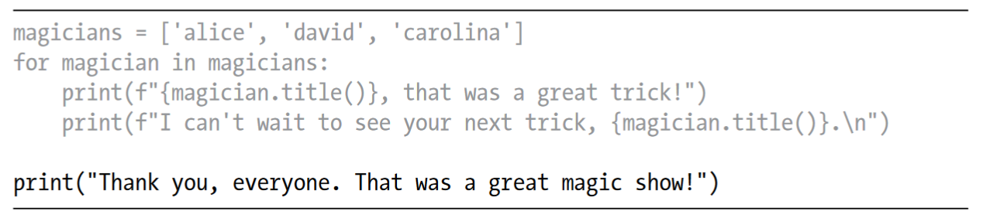
Doing Something After a for Loop
Any lines of code after the for loop that are not indented are executed once without repetition.

Slide 8
Avoiding Indentation Errors
Python uses indentation to determine how a line, or group of lines, is related to the rest of the program.
As you begin to write code that relies on proper indentation, you’ll need to watch for a few common indentation errors. For example, people sometimes indent lines of code that don’t need to be indented or forget to indent lines that need to be indented.

Slide 9
Avoiding Indentation Errors
Examples of indentation errors:
Forgetting to indent
Forgetting to indent additional lines
Indenting unnecessarily
Indenting unnecessarily after the loop
Forgetting the colon

Slide 10
Making Numerical Lists
Lists are ideal for storing sets of numbers, and Python provides a variety of tools to help you work efficiently with lists of numbers.
Once you understand how to use these tools effectively, your code will work well even when your lists contain millions of items.

Slide 11
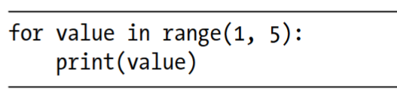
Using the range() function
Python’s range() function makes it easy to generate a series of numbers.

Slide 12
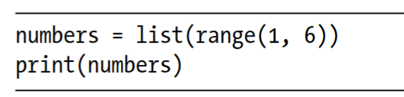
Using range() to Make a List of Numbers
If you want to make a list of numbers, you can convert the results of range() directly into a list using the list() function.
When you wrap list() around a call to the range() function, the output will be a list of numbers

Slide 13
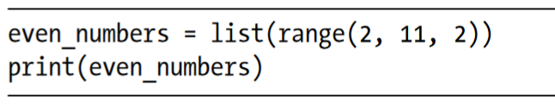
Using range() to Make a List of Numbers
We can also use the range() function to tell Python to skip numbers in a given range. If you pass a third argument to range(), Python uses that value as a step size when generating numbers.

Slide 14
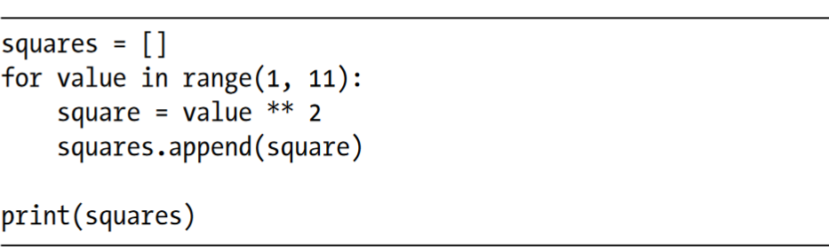
Using range() to Make a List of Numbers
You can create almost any set of numbers you want to using the range() function.
For example, consider how you might make a list of the first 10 square numbers (that is, the square of each integer from 1 through 10). In Python, two asterisks (**) represent exponents. Here’s how you might put the first 10 square numbers into a list:

Slide 15
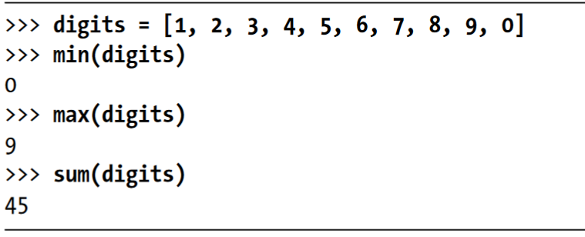
Simple Statistics with a List of Numbers
A few Python functions are helpful when working with lists of numbers. For example, you can easily find the minimum, maximum, and sum of a list of numbers

Slide 16
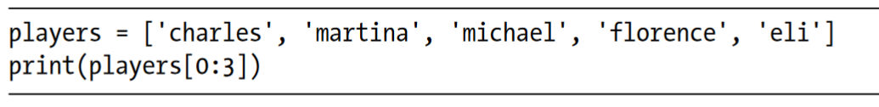
Slicing a List
To make a slice, you specify the index of the first and last elements you want to work with. As with the range() function, Python stops one item before the second index you specify
This code prints a slice of the list. The output retains the structure of the list, and includes the first three players in the list

Slide 17
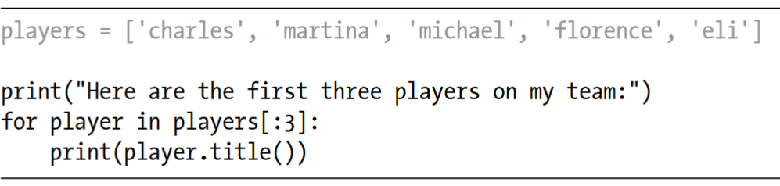
Looping Through a Slice
You can use a slice in a for loop if you want to loop through a subset of the elements in a list. In the next example, we loop through the first three players and print their names as part of a simple roster:
Instead of looping through the entire list of players, Python loops through only the first three names

Slide 18
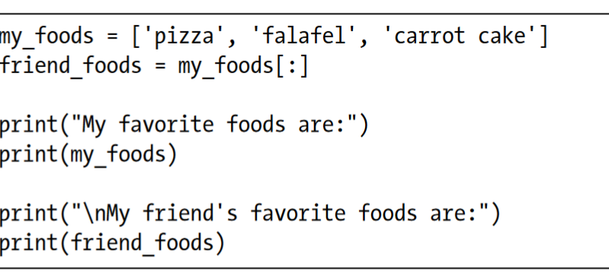
Copying a List
To copy a list, you can make a slice that includes the entire original list by omitting the first index and the second index ([:]). This tells Python to make a slice that starts at the first item and ends with the last item, producing a copy of the entire list.

Slide 19
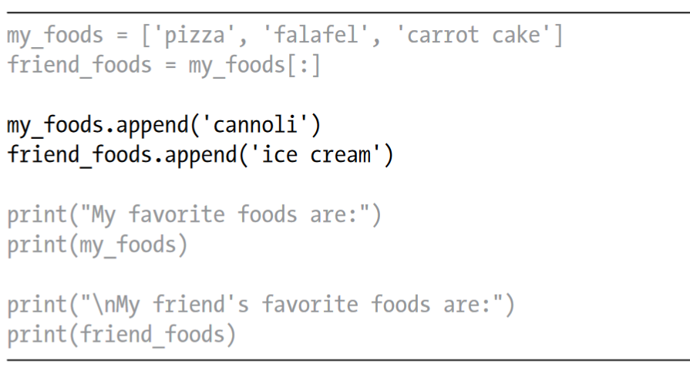
Copying a List
To prove that we actually have two separate lists, we’ll add a new food to each list and show that each list keeps track of the appropriate person’s favorite foods

Slide 20
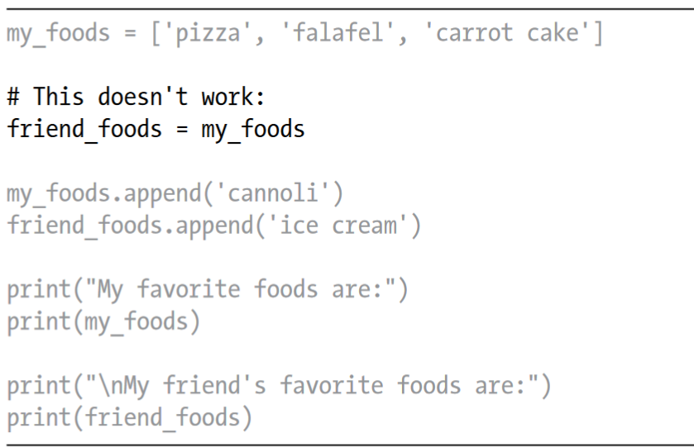
Copying a List
Here’s what happens when you try to copy a list without using a slice.

Slide 21
Copying a List
Instead of assigning a copy of my_foods to friend_foods, we set friend_foods equal to my_foods. This syntax actually tells Python to associate the new variable friend_foods with the list that is already associated with my_foods, so now both variables point to the same list.
As a result, when we add 'cannoli’ to my_foods, it will also appear in friend_foods. Likewise 'ice cream' will appear in both lists, even though it appears to be added only to friend_foods

Slide 22
Tuples
Lists work well for storing collections of items that can change throughout the life of a program. The ability to modify lists is particularly important when you’re working with a list of users on a website or a list of characters in a game.
However, sometimes you’ll want to create a list of items that cannot change.
Tuples allow you to do just that. Python refers to values that cannot change as immutable, and an immutable list is called a tuple.

Slide 23
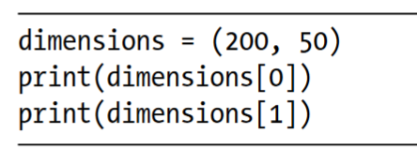
Defining a Tuple
A tuple looks just like a list, except you use parentheses instead of square brackets. Once you define a tuple, you can access individual elements by using each item’s index, just as you would for a list.

Slide 24
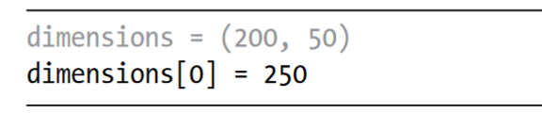
Defining a Tuple
Let’s see what happens if we try to change one of the items in the tuple dimensions
This code tries to change the value of the first dimension, but Python returns a type error. Because we’re trying to alter a tuple, which can’t be done to that type of object, Python tells us we can’t assign a new value to an item in a tuple

Slide 25
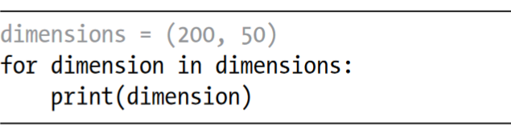
Looping Through All Values in a Tuple
You can loop over all the values in a tuple using a for loop, just as you did with a list

Slide 26
Looping Through All Values in a Tuple
You can loop over all the values in a tuple using a for loop, just as you did with a list

Slide 27
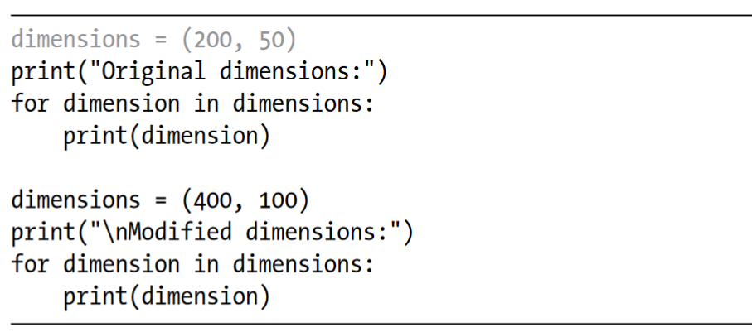
Writing Over a Tuple
Although you can’t modify a tuple, you can assign a new value to a variable that represents a tuple. For example, if we wanted to change the dimensions of this rectangle, we could redefine the entire tuple

Slide 28
Summary of Chapter 4
In this chapter, you learned how to work efficiently with the elements in a list.
You learned how to work through a list using a for loop, how Python uses indentation to structure a program, and how to avoid some common indentation errors.
You learned to make simple numerical lists, as well as a few operations you can perform on numerical lists.
You learned how to slice a list to work with a subset of items and how to copy lists properly using a slice.
You also learned about tuples, which provide a degree of protection to a set of values that shouldn’t change.

